Slide 1
NYC Green taxi Analysis for February 2016
Yixuan Zhou
Feb 20, 2021

Slide 2
Download the data, load it into python. Report the number of rows and columns that you've loaded.

Slide 3
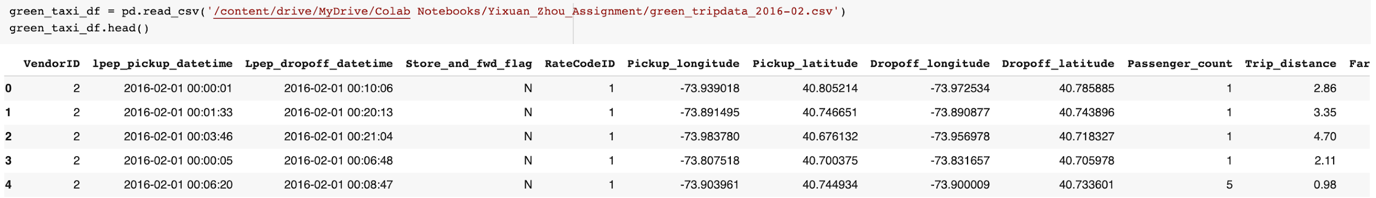
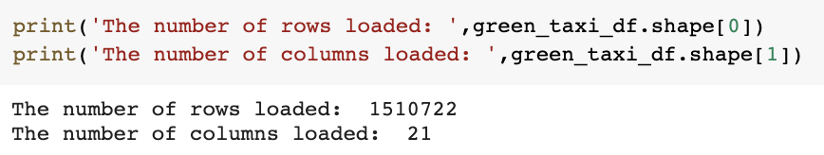

Slide 4
2. Visualize trip distance by time of day in any way you see fit, any observations?

Slide 5
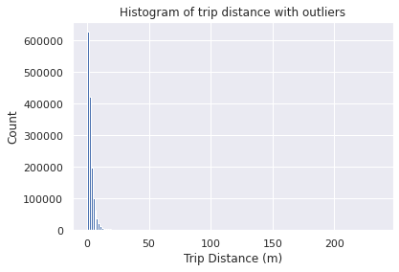
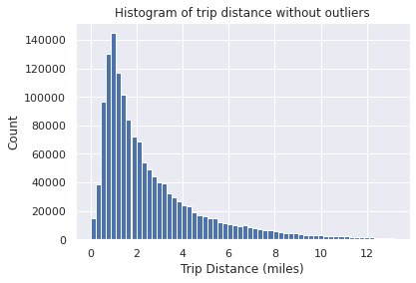
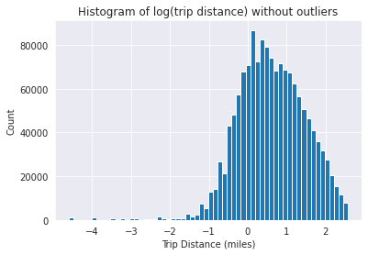
Histogram of Trip Distance
Skew Coefficient before preprocessing: 4.268
Counts of Zeros:
18964
Skew Coefficient before preprocessing: 1.770
Counts of Zeros:
0
Notes:
From the figure above, it implies the distance data is skewed by outliers. So we should do some preprocessing at first!
The trip distance data without outliers is defined as distance is not positive and located further than 3 standard deviations from the mean. We assume that the trips are not random, there have non-zero autocorrelation which may due to the working man behavior like rushing to work. hence the trip distance distribution is not a symmetric Gaussian distribution.

Slide 6
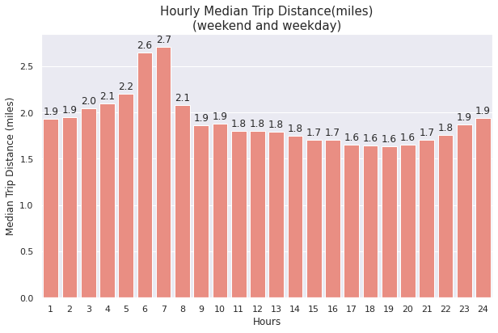
Hourly Median Trip Distance in both weekday and weekends (aka all data)
The median trip distance is longer at 6am and 7am than other times of the day.
The overall trend of median trip distance is increasing from 1am to 7am, and then dramatically decreased to 2.1 miles at 8am.
The distance is lowest during 17pm to 20pm in the time of day.

Slide 7
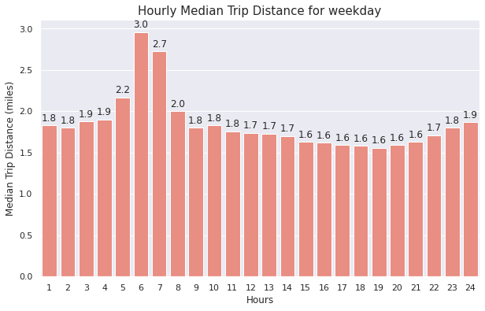
Hourly Median Trip Distance for weekday
Longer median trip distance at 6am and 7am with the longest trip distance at 6am.
The shorter trip distance during 1am to 5am and 15am to 21am may due to less people go to work by green taxi before go to work and after duty.
The evening peak is shorter than the morning peak, I suspect that people like to take taxes to work in order to avoid being late.
Notes:
Similar with the graph above, people takes green taxi for the longer median trip distance at 6am and 7am. And people takes taxi with the longest trip distance at 6am. Because this graph used the weekday trip distance data, my thinking is that most taxi are used for commuting to work which starting at near 8am. What's more, people who tend to commute by taxi should be living further from their company location. Regarding the slightly longer trip distance at 6am compared to 7am, I think it's due to more people take taxi at 6am to work than at 7am.
It's obvious that the shorter trip distance during 1am to 5am and 15am to 21am may due to less people go to work by green taxi before go to work and after duty. But it's interesting that how do people get back home? Maybe they will take vehicles or transportation that are cheaper than green taxi.
The evening peak is shorter than the morning peak, I suspect that people like to take taxes to work in order to avoid being late.

Slide 8
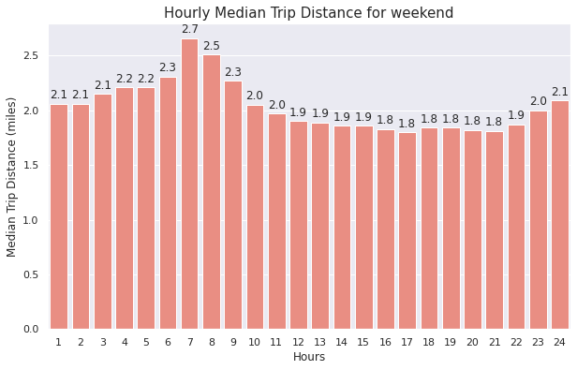
Hourly Median Trip Distance for weekend
Longer trip distance happens at 7am and 8am, with 7am has the longest median trip distance
Its median trip distance is smaller than highest distance on weekday
Difference between the longer median trip distance at 7am and 8am and the rest of the data is not as significantly large as for the weekends
Notes:
Here we visualize the median trip distance on weekend. It's noticed that the longer trip distance happens at 7am and 8am, and 7am has the longest median trip distance on weekend and its median trip distance is smaller than highest distance on weekday.
I also noticed that the difference between the longer median trip distance at 7am and 8am and the rest of the data is not as significantly large as for the weekends. My assumptions are as following:
People don't have to commute to work at early morning on weekends. Hence, the peak of hourly median trip distance is shifted one hour later than that of weekdays.
The lower median trip distances on weekends are commonly higher than that on weekdays. I think people would be taking part in some kind of recreations on weekends,therefore, they may stay late outside in the evening, go to airport for traveling or working, shopping or having a picnic in the afternoon, and then take green taxi to go back home.

Slide 9
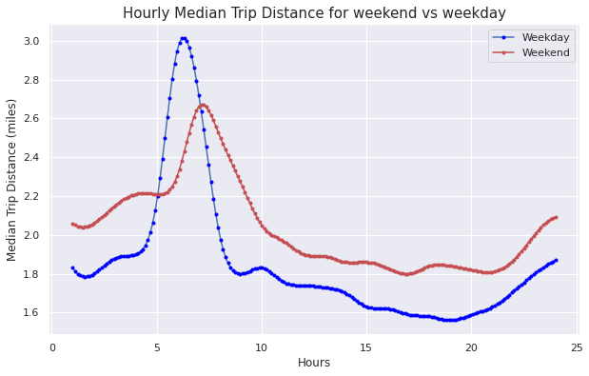
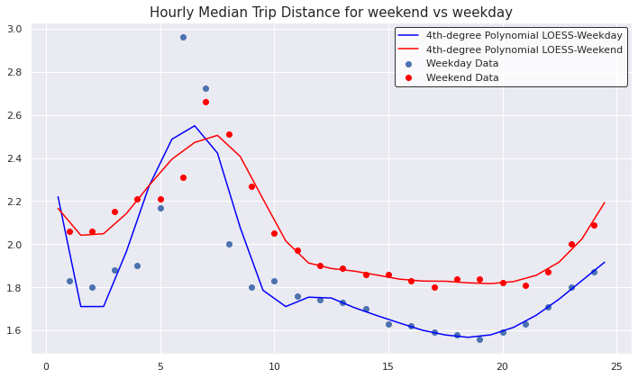
Comparison between hourly median trip distance in weekday and weekend
Median trip tends to be longer on weekends than on weekdays. And overall, the longest trip is in the early morning period

Slide 10
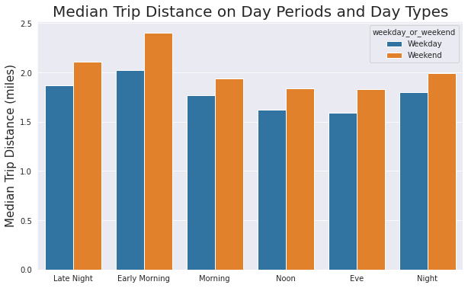
Comparison between hourly median trip distance in weekday and weekend
Median trip tends to be longer on weekends than on weekdays.
Overall, the longest trip is in the early morning period

Slide 11
Q3: What are the most popular pickup locations on weekends vs weekdays?

Slide 12
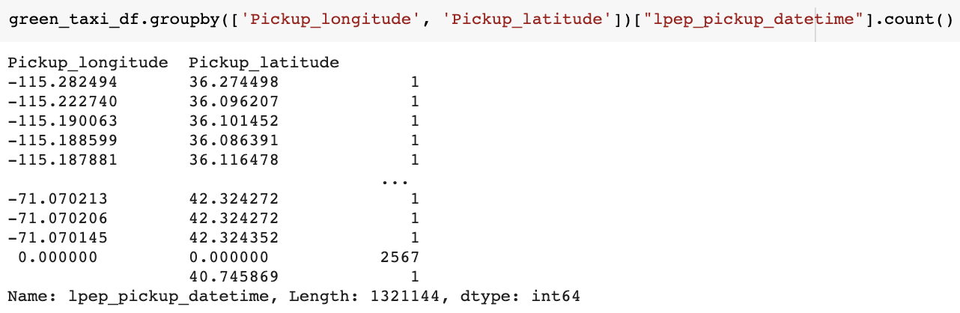
Pickup Location Data Exploration
There are outliers in the pickup location!!

Slide 13
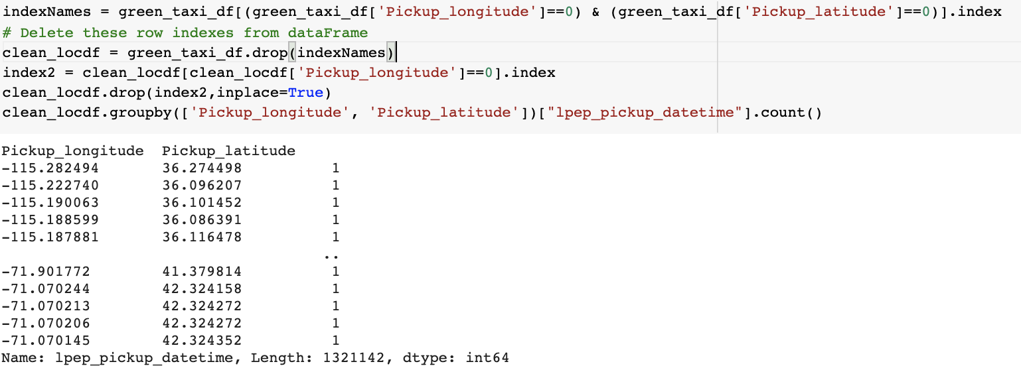
Preprocessing the pickup location data

Slide 14
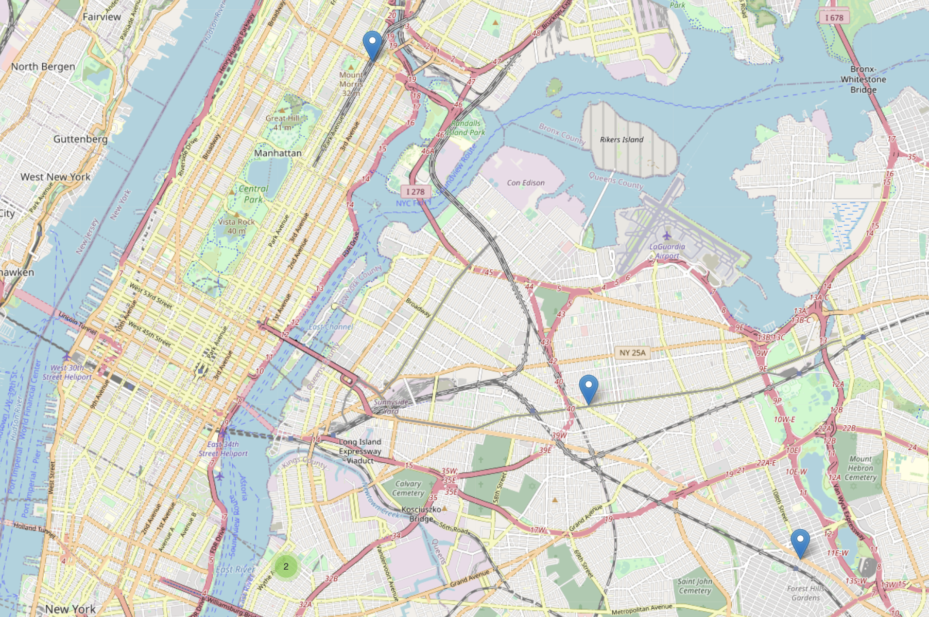
Weekend Popular Pickup Locations
The Top 5 Weekend Pickup Locations in Feb 2016:
Jackson Heights 74th Street - Roosevelt Avenue (7), Broadway, Queens, Queens County, New York, 11373, United States: (6471 pickups)
107-34, 71st Avenue, Queens, Queens County, New York, 11375, United States: (5252 pickups)
East 125th Street, East Harlem, Manhattan Community Board 11, Manhattan, New York County, New York, 10035-3501, United States: (4792 pickups)
82, Wythe Avenue, Greenpoint, Brooklyn, Kings County, New York, 11249, United States: (4512 pickups)
160, North 7th Street, Williamsburg, Brooklyn, Kings County, New York, 11249, United States: (2770 pickups)
Notes:
I use folium for map visualization, and Geopy for geocoding reversing to address names

Slide 15
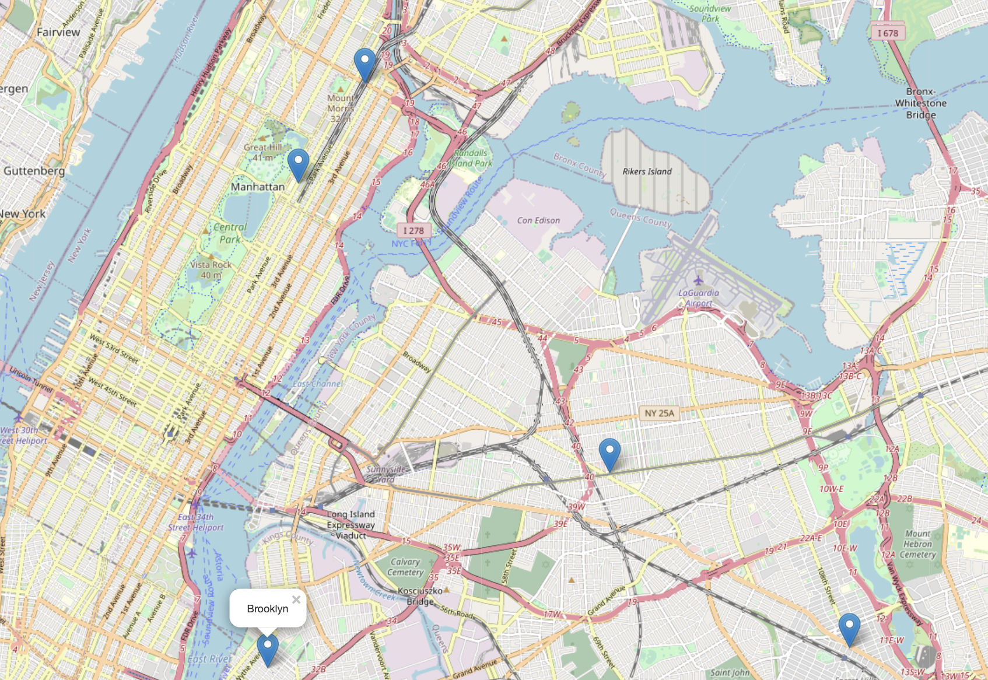
Weekday Popular Pickup Locations
The Top 5 Weekday Pickup Locations in Feb 2016:
107-34, 71st Avenue, Queens, Queens County, New York, 11375, United States: (13993 pickups)
East 125th Street, East Harlem, Manhattan Community Board 11, Manhattan, New York County, New York, 10035-3501, United States: (13243 pickups)
Jackson Heights 74th Street - Roosevelt Avenue (7), Broadway, Queens, Queens County, New York, 11373, United States: (12578 pickups)
1465, Madison Avenue, East Harlem, Manhattan Community Board 11, Manhattan, New York County, New York, 10029, United States: (4512)
160, North 7th Street, Williamsburg, Brooklyn, Kings County, New York, 11249, United States: (6110)

Slide 16
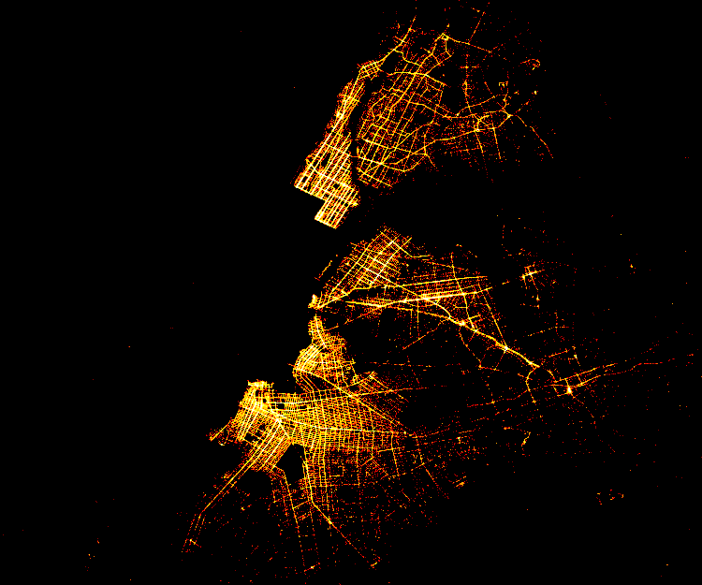
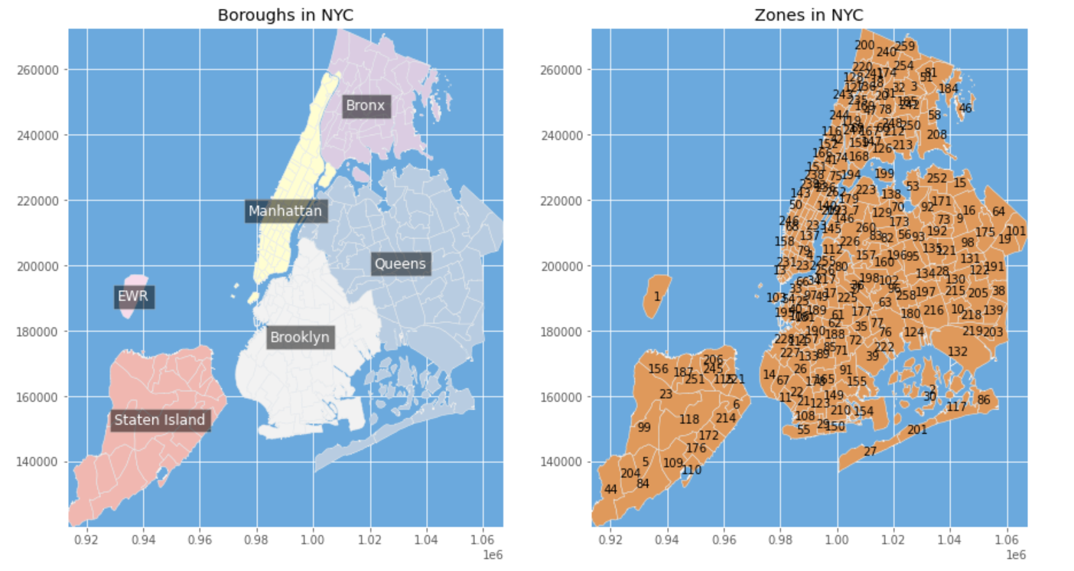
Visualization of Pickup Location
Notes:
The left one is Pickup Location with highlighted trip distance
The right one is outlook of study area

Slide 17
Q4. Build a model to forecast the number of trips by hour for the next 12 hours after Feb 12th 10:00 am. How well did you do?

Slide 18
Time Series Forecasting with Prophet
Introduction:
Prophet is an open-source library developed by Facebook and designed for automatic forecasting of univariate time series data
Advantages:
It works best with time series that have strong seasonal effects and several seasons of historical data. Prophet is robust to missing data and shifts in the trend, and typically handles outliers well

Slide 19
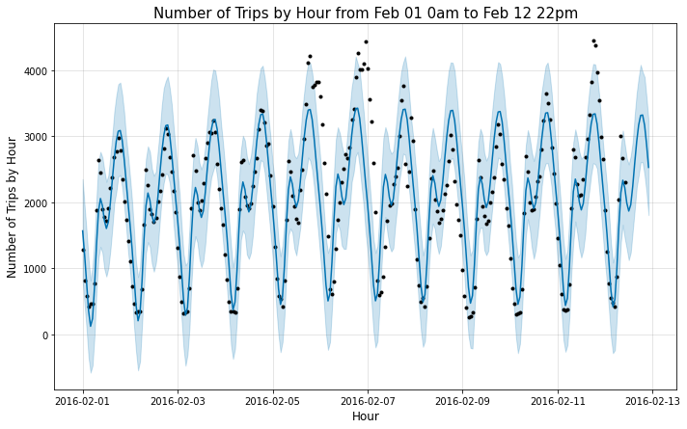
Time Series Forecasting with Prophet
Fit model with all hourly aggregated data from Feb 1 0am to Feb 12 10am, then use the trained model to predict number of trips by hour from Feb 1 0am to Feb 12 22pm (including training time series and the next 12 hour values):
Cyclical patterns in the data
Forecasted hourly trips is a good match for the real observations, especially when the bounds are taken into account
The lower and upper bounds on the predicted value (‘yhat_lower‘ and ‘yhat_upper‘) that provide uncertainty of the forecast

Slide 20
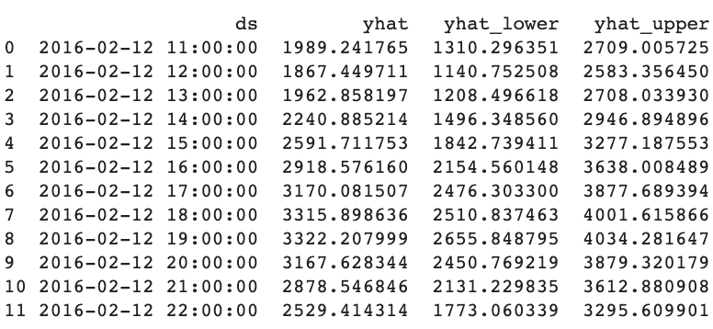
Forecasted Number of Hourly Trips for Next 12 Hours

Slide 21
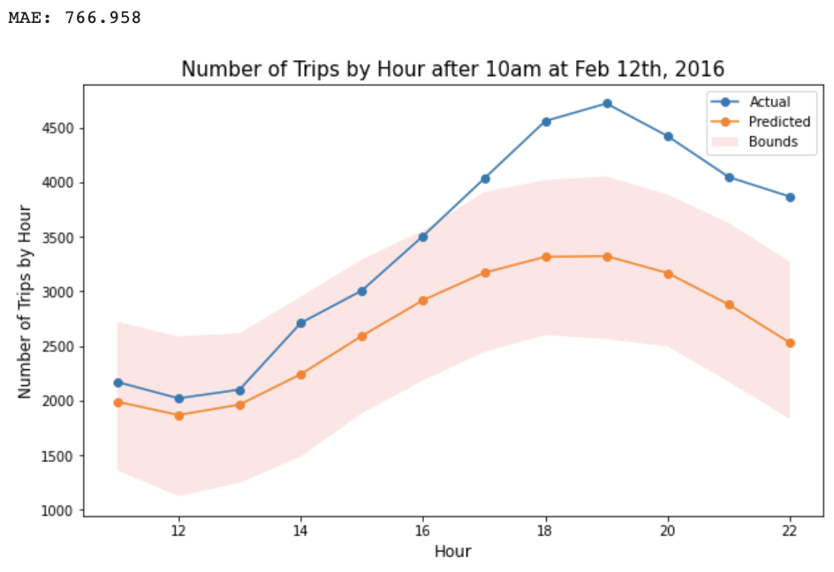
Model Evaluating
The model predicted well in the lower/valley part of number of trips by hour (11:00 to 13:00), but not so good at the higher/peak part (14:00 to 22:00).
Overall, the predicted model performs good with mean absolute error of 767 trips. However, the upper and lower bounds estimations are calculated, and this predicted range of number of trips is very close to all actual values!!

Slide 22
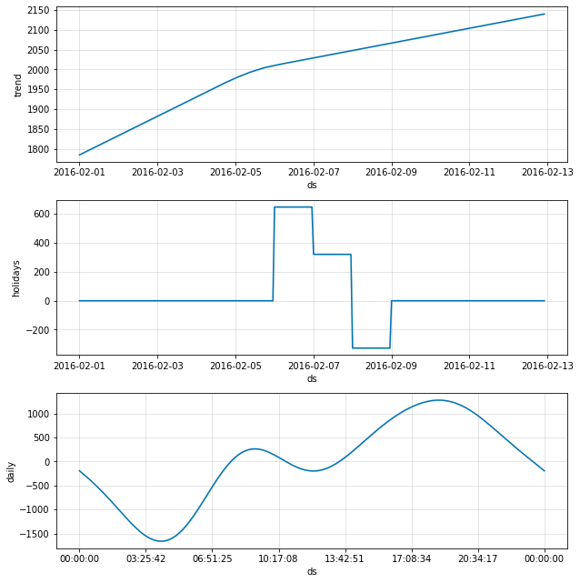
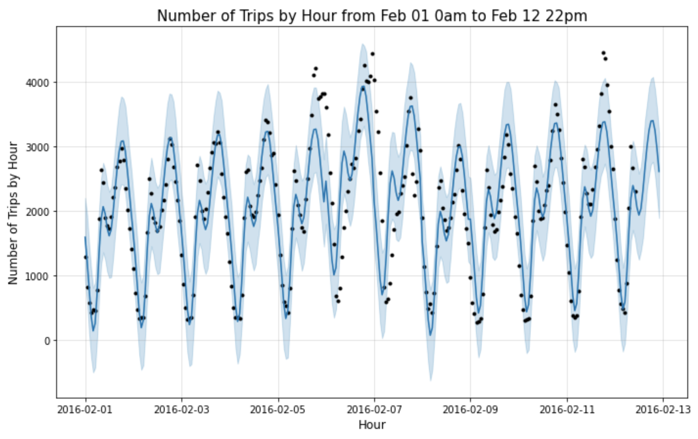
Time Series Forecasting with Prophet incorporating Weekend Effect
Notes:
In addition, Prophet can also incorporate possible effects from manually specified time range.
Our component plot now includes a holidays component, which is the weekends we specified), with spikes indicating the magnitude of influence those holidays have on the value.

Slide 23
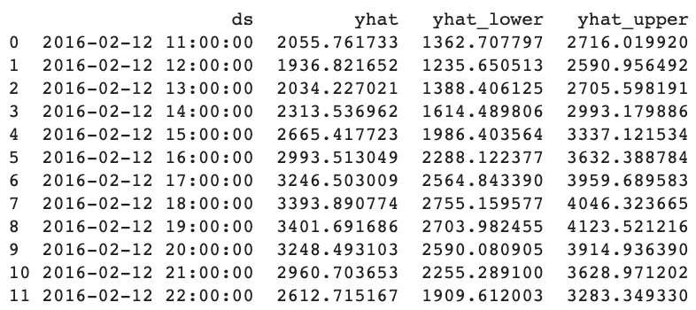
Forecasted Number of Hourly Trips for Next 12 Hours
(take weekend effects into consideration)

Slide 24
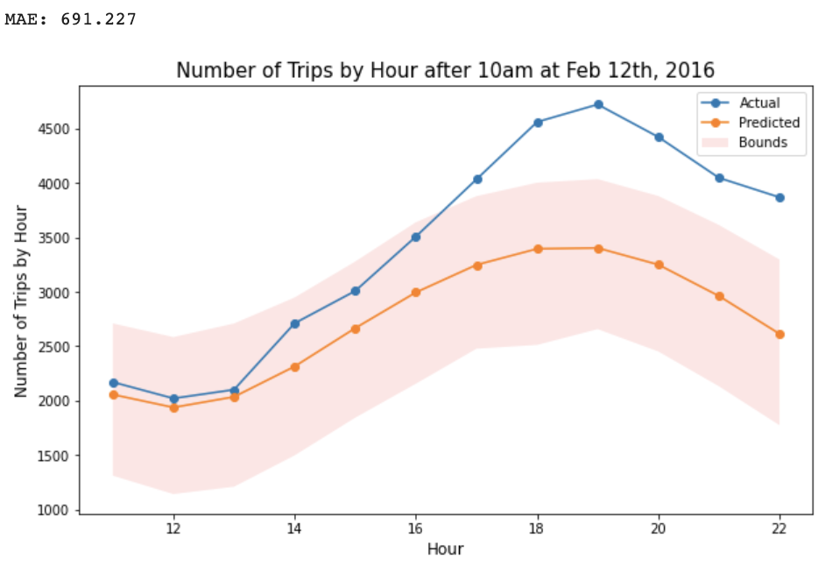
Model Evaluating
After taking the weekend effects into consideration, we see that the mean absolute error decreased from 767 to 691!!

Slide 25
Time Series Forecasting with Prophet: Vendor Category
Predict by vendor category, and take weekend effects into consideration
VendorID:
A code indication LPEP provider that provided the record
1=Creative Mobile Technologies,LLC
2=VeriFone Inc

Slide 26
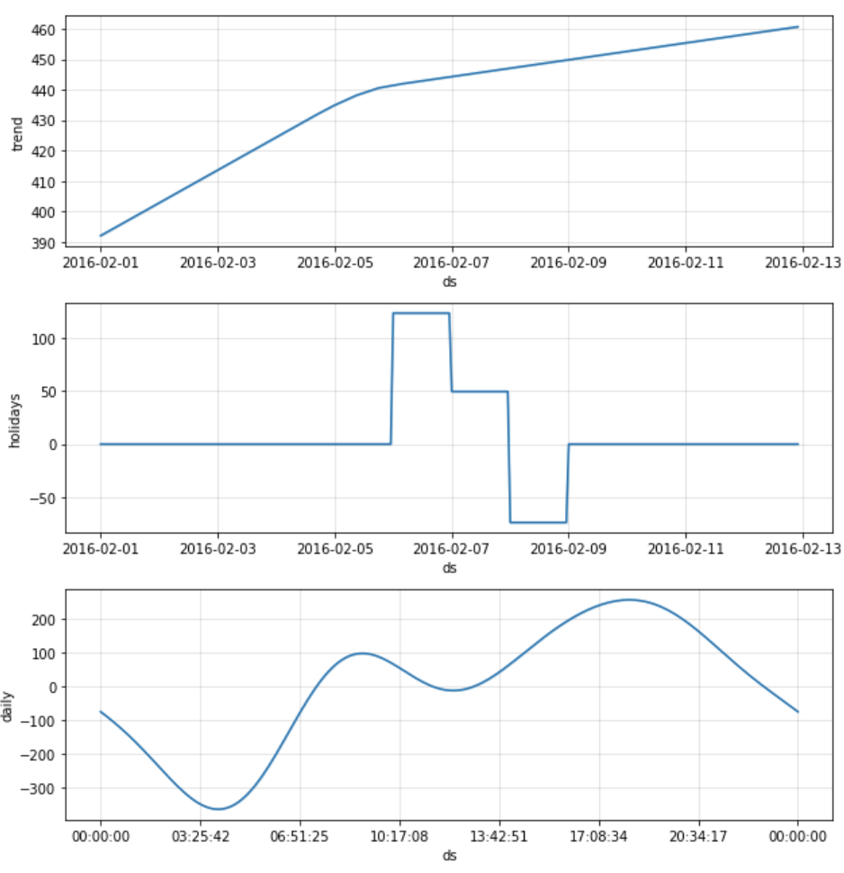
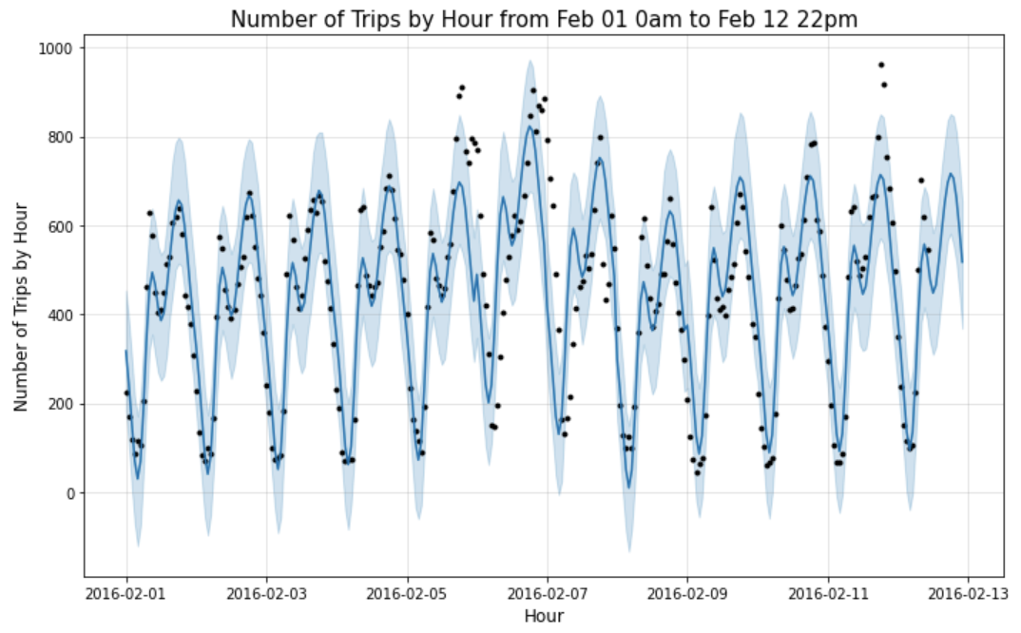
Vendor 1: Creative Mobile Technologies,LLC

Slide 27
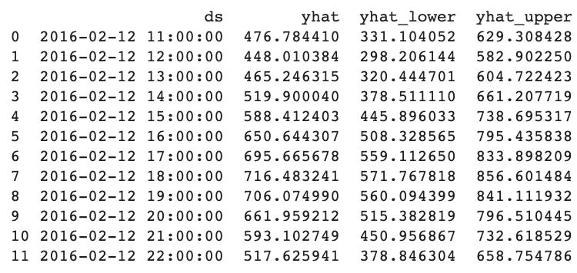
Vendor 1:Forecasted Number of HourlyTrips for Next 12 Hours

Slide 28
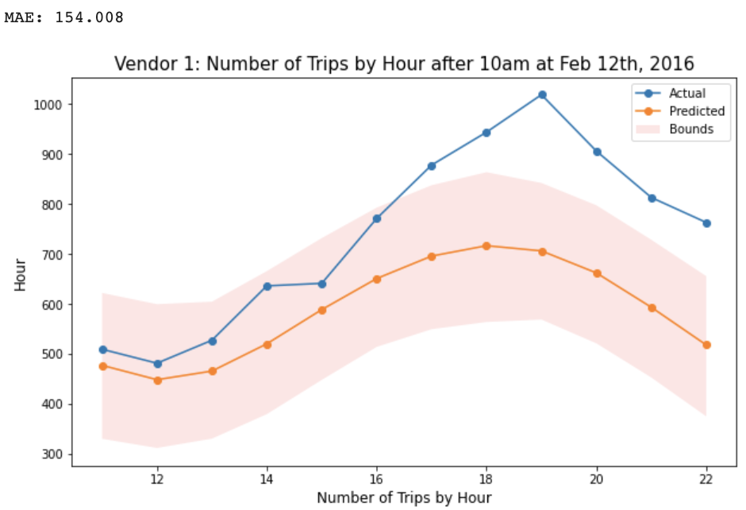
Vendor 1: Model Evaluation
For vendor 1, we see that the mean absolute error decreased from 691 to 154!!

Slide 29
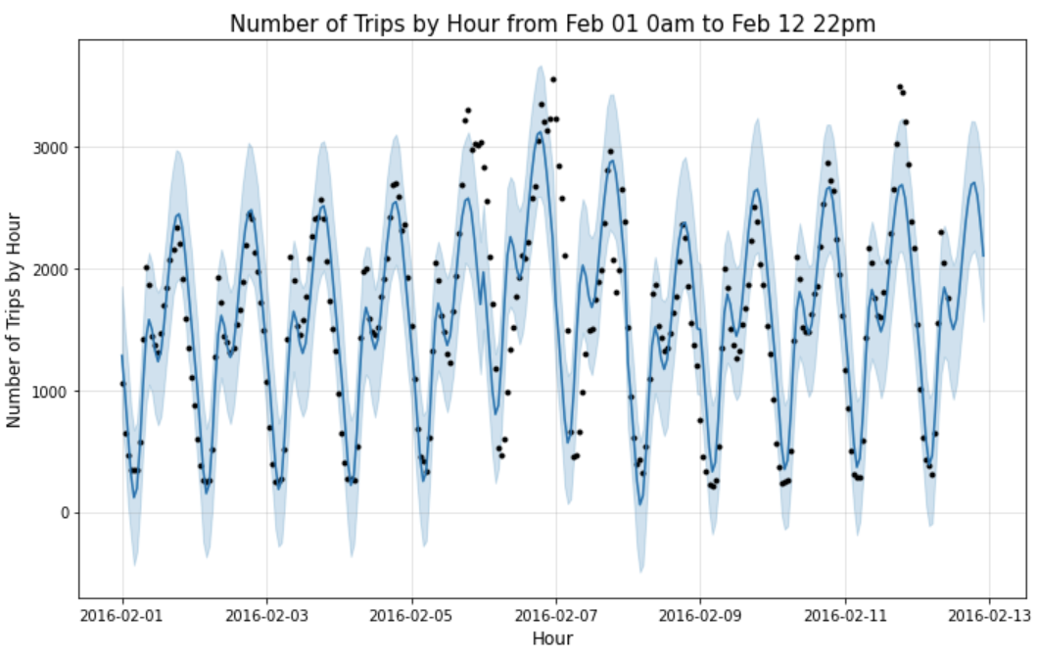
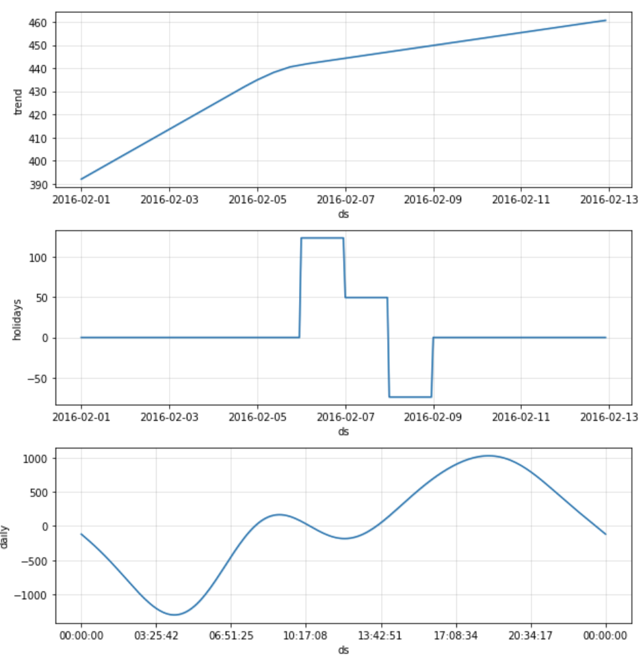
Vendor 2: VeriFone Inc

Slide 30
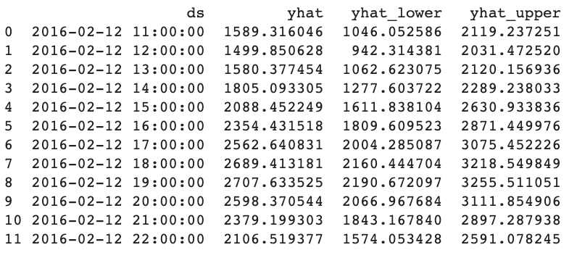
Vendor 2:Forecasted Number of Hourly Trips for Next 12 Hours

Slide 31
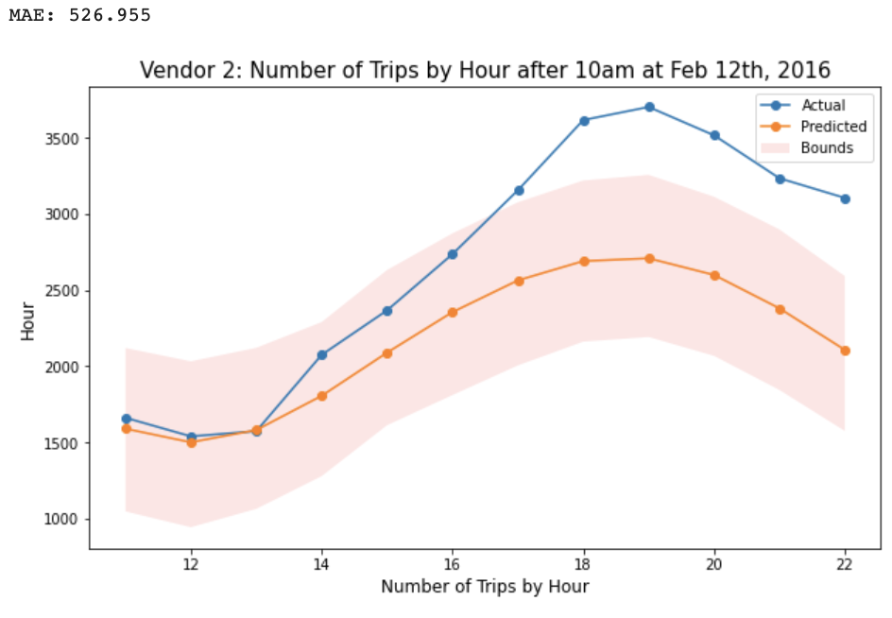
Vendor 2: Model Evaluation
For vendor 2, we see that the mean absolute error decreased from 691 to 527!!

Slide 32
Time Series Forecasting with LSTM
Introduction:
Long Short-Term Memory network is a type of recurrent neural network used in deep learning because very large architectures can be successfully trained
Advantages:
Robust to Noise
Nonlinear
Multi-Step Forecasts

Slide 33
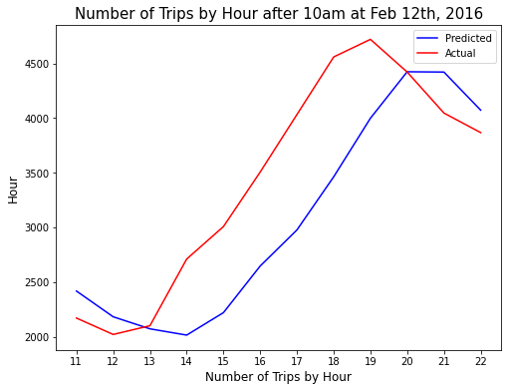
Forecasted Number of Hourly Trips and Model Evaluation
Predict Number of Hourly Trips
(Feb 12 11am to 22pm):
2016-02-12 11:00:00: 2370
2016-02-12 12:00:00: 2137
2016-02-12 13:00:00: 2026
2016-02-12 14:00:00: 1972
2016-02-12 15:00:00: 2187
2016-02-12 16:00:00: 2612
2016-02-12 17:00:00: 2950
2016-02-12 18:00:00: 3444
2016-02-12 19:00:00: 3990
2016-02-12 20:00:00: 4415
2016-02-12 21:00:00: 4400
2016-02-12 22:00:00: 4043
Predict Number of Hourly Trips
(Feb 12 11am to 22pm)
Mean Absolute Error: 519.8
Mean Squared Error: 412774.7
Notes:
From the graph, we can see the general trend of predicted hourly trips is similar to that of actual hourly trips from 11am to 22pm at Feb 12th. The calculated mean absolute error is 520, which is much lower than 767 of Prophet model.

Slide 34
Multivariate Forecasted Number of Hourly Trips and Model Evaluation
Input Features:
Hourly Median Trip Distance
Hourly Median Fare Amount
Hourly Median Tolls Amount
Hourly Median Total Amount
Hourly Total Number of Trips
Window Size
This hour's forecast value depends on last 2-hour multivariate values

Slide 35
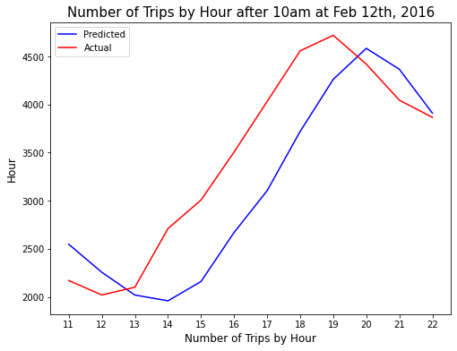
Forecasted Number of Hourly Trips and Model Evaluation
Predict Number of Hourly Trips
(Feb 12 11am to 22pm):
2016-02-12 11:00:00: 2546
2016-02-12 12:00:00: 2255
2016-02-12 13:00:00: 2019
2016-02-12 14:00:00: 1958
2016-02-12 15:00:00: 2159
2016-02-12 16:00:00: 2669
2016-02-12 17:00:00: 3104
2016-02-12 18:00:00: 3721
2016-02-12 19:00:00: 4262
2016-02-12 20:00:00: 4584
2016-02-12 21:00:00: 4367
2016-02-12 22:00:00: 3910
Mean Absolute Error: 490.0
Mean Squared Error: 340901.7
Notes:
From the graph, we can see the general trend of predicted hourly trips is similar to that of actual hourly trips from 11am to 22pm at Feb 12th. The calculated mean absolute error is 490, which is much lower than 767 of Prophet model and 520 of univariate LSTM model!!

Slide 36
Thank You!

Slide 37
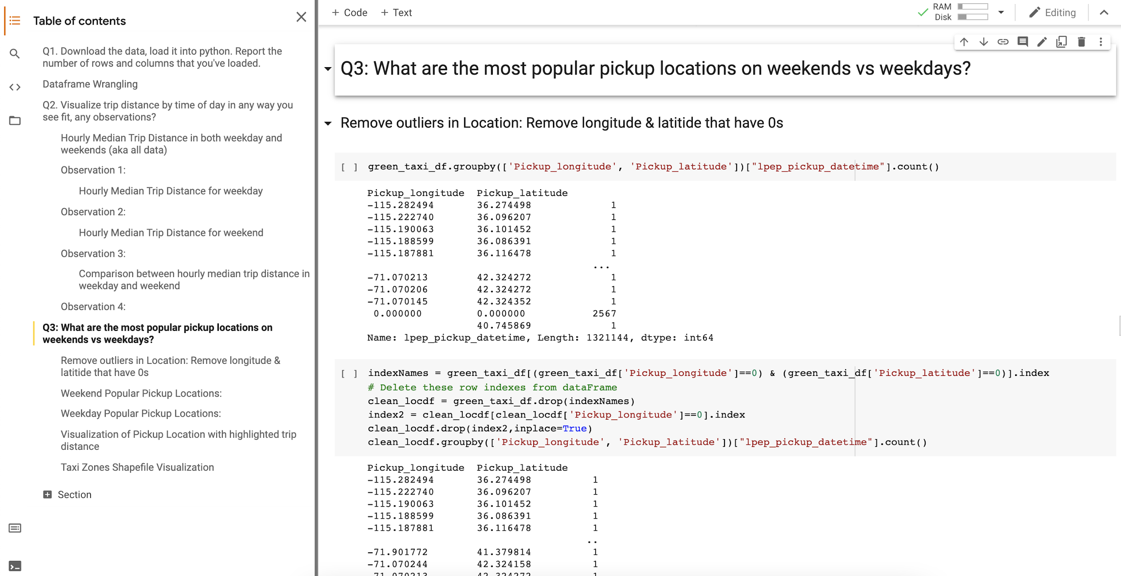
Tips in Colab: Table of Contents
Notes:
You can open the table of contents for quick review. And you could connect with GPU/CPU runtime as you like. Cheers ^_^

